Slide 1
故事七步驟--開台插曲
(Vtube Studio)

Slide 2
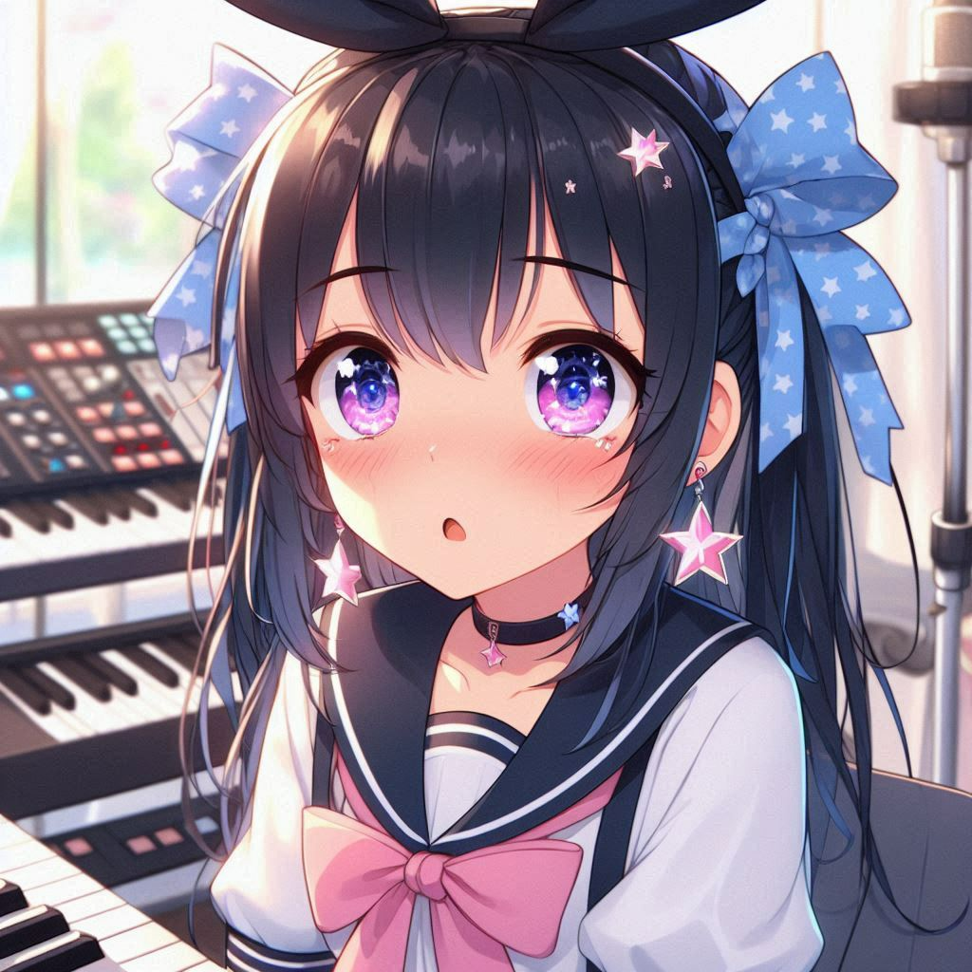
目標
Notes:
Anime style.A girl anxiously prepares several materials such as songs, teaser in a streaming room. She has long black hair tied into twin tails with a blue ribbon. She wears a black bunny ears headdress with a pink bow. Her eyes were large and bright pink with a slight blush and twinkle. Her nose is small and delicate, her lips are pink, her skin is fair, and she wears star-shaped earrings on her ears. She wore a white and blue dress with a red and white pattern. The dress has a deep V-neck neckline, long sleeves with white cuffs, and white lace gloves on the wrists. She also wore black pantyhose and blue heels that were decorated with a red chevron pattern.
在決定以個人勢的身分出道之後，開始陸續準備各種開台需要的東西，像是出道預告、影片素材、找PV師、確認開台環境的隔音和收音設備沒問題等等。
希望能夠在萬全的準備下給觀眾一個完美的初配信(出道直播)!

Slide 3
目標
出道預告
影片素材
找PV師
確認開台環境的 隔音和收音設備
Notes:
Anime style.A girl anxiously prepares several materials such as songs, teaser in a streaming room. She has long black hair tied into twin tails with a blue ribbon. She wears a black bunny ears headdress with a pink bow. Her eyes were large and bright pink with a slight blush and twinkle. Her nose is small and delicate, her lips are pink, her skin is fair, and she wears star-shaped earrings on her ears. She wore a white and blue dress with a red and white pattern. The dress has a deep V-neck neckline, long sleeves with white cuffs, and white lace gloves on the wrists. She also wore black pantyhose and blue heels that were decorated with a red chevron pattern.
在決定以個人勢的身分出道之後，開始陸續準備各種開台需要的東西，像是出道預告、影片素材、找PV師、確認開台環境的隔音和收音設備沒問題等等。
希望能夠在萬全的準備下給觀眾一個完美的初配信(出道直播)!

Slide 4
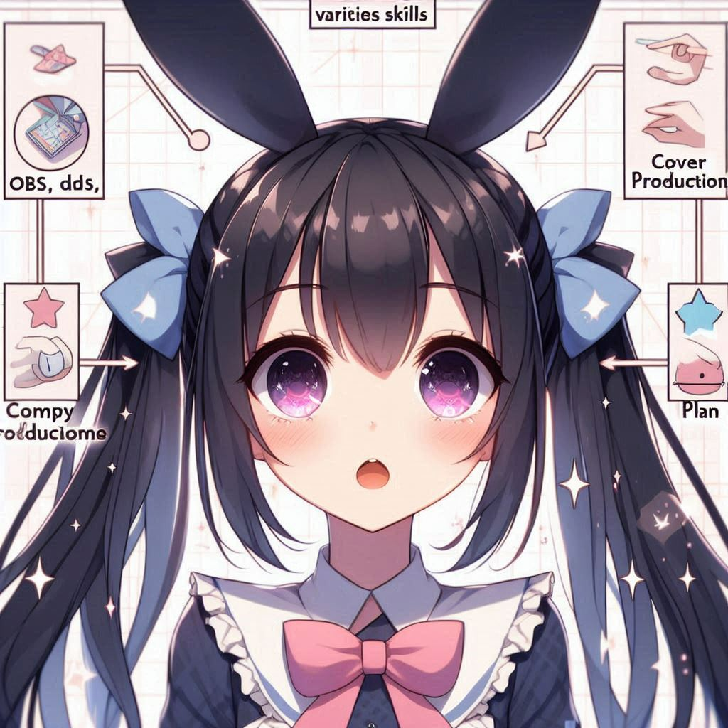
阻礙
Notes:
Anime style. A girl learns various skills, OBS, LIVE2D, cover production, copywriting, and plan writing. She has long black hair tied into twin tails with a blue ribbon. She wears a black bunny ears headdress with a pink bow. Her eyes were large and bright pink with a slight blush and twinkle. Her nose is small and delicate, her lips are pink, her skin is fair, and she wears star-shaped earrings on her ears. She wore a white and blue dress with a red and white pattern. The dress has a deep V-neck neckline, long sleeves with white cuffs, and white lace gloves on the wrists. She also wore black pantyhose and blue heels that were decorated with a red chevron pattern.
由於是個人一手包辦，所以需要不斷學習各種技能，OBS、LIVE2D、封面製作、文案和企劃書撰寫等等才可以盡可能減少開支。
但是除此之外，為了讓初配信有人來看，決定在出道前100天每日製作並上傳SHORTS增加曝光度。
因此不會剪輯的我必須在短時間內學會如何剪輯、挑選素材、跟隨演算法等等。

Slide 5
阻礙
每日上傳影片直到出道 Day 1 記錄我要學習哪些東西
OBS
封面製作
LIVE2D
剪輯
文案和企劃書撰寫
Notes:
Anime style. A girl learns various skills, OBS, LIVE2D, cover production, copywriting, and plan writing. She has long black hair tied into twin tails with a blue ribbon. She wears a black bunny ears headdress with a pink bow. Her eyes were large and bright pink with a slight blush and twinkle. Her nose is small and delicate, her lips are pink, her skin is fair, and she wears star-shaped earrings on her ears. She wore a white and blue dress with a red and white pattern. The dress has a deep V-neck neckline, long sleeves with white cuffs, and white lace gloves on the wrists. She also wore black pantyhose and blue heels that were decorated with a red chevron pattern.
由於是個人一手包辦，所以需要不斷學習各種技能，OBS、LIVE2D、封面製作、文案和企劃書撰寫等等才可以盡可能減少開支。
但是除此之外，為了讓初配信有人來看，決定在出道前100天每日製作並上傳SHORTS增加曝光度。
因此不會剪輯的我必須在短時間內學會如何剪輯、挑選素材、跟隨演算法等等。

Slide 6


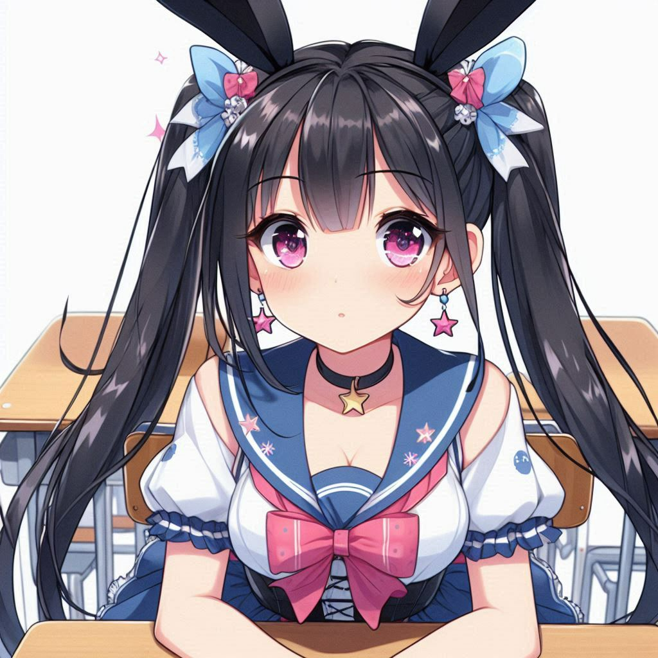
努力
Notes:
Anime style. Studing scene.A girl went to lesson to learn Japanese culture.She has long black hair tied into twin tails with a blue ribbon. She wears a black bunny ears headdress with a pink bow. Her eyes were large and bright pink with a slight blush and twinkle. Her nose is small and delicate, her lips are pink, her skin is fair, and she wears star-shaped earrings on her ears. She wore a white and blue dress with a red and white pattern. The dress has a deep V-neck neckline, long sleeves with white cuffs, and white lace gloves on the wrists. She also wore black pantyhose and blue heels that were decorated with a red chevron pattern.
為了能夠順利出道，我拚盡了全力，日以繼夜地學習和加強新技能，甚至可能不會用到的都一併學了起來、像是3D建模、Vroid 模型製作、unity和github的基礎使用等。
怕以後和日本的朋友合作開台時無法快速理解他們的梗，連日本文化、日本文學史、日本近現在文學都特地去上了課。
在邊吸收知識的同時每日製作shorts並上傳，痛苦卻充實地度過每一天

Slide 7

結果
出道囉!!!
Notes:
A girl holds a mic standing on the stage. She has long black hair tied into twin tails with a blue ribbon. She wears a black bunny ears headdress with a pink bow. Her eyes were large and bright pink with a slight blush and twinkle. Her nose is small and delicate, her lips are pink, her skin is fair, and she wears star-shaped earrings on her ears. She wore a white and blue dress with a red and white pattern. The dress has a deep V-neck neckline, long sleeves with white cuffs, and white lace gloves on the wrists. She also wore black pantyhose and blue heels that were decorated with a red chevron pattern.
總算在努力半年後，差不多將開台與未來會使用到的技能都學會了，shorts也發滿一百天在出道前順利得到一萬訂閱後，正式決定在愚人節當天出道!

Slide 8

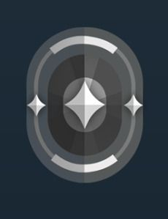

意外
Notes:
Anime style. Proud face. A girl steps on a tons of pro gamer. She has long black hair tied into twin tails with a blue ribbon. She wears a black bunny ears headdress with a pink bow. Her eyes were large and bright pink with a slight blush and twinkle. Her nose is small and delicate, her lips are pink, her skin is fair, and she wears star-shaped earrings on her ears. She wore a white and blue dress with a red and white pattern. The dress has a deep V-neck neckline, long sleeves with white cuffs, and white lace gloves on the wrists. She also wore black pantyhose and blue heels that were decorated with a red chevron pattern.
在忙東忙西，正式訂下出道日期後才突然想到，自己忘記去了解和練習現在的流行遊戲，特別是FPS遊戲，畢竟相較其他遊戲更能夠持續的吸引觀眾的目光!
因此，我緊急開辦帳號大量看遊戲教學影片，在出道前奠定好遊戲基礎避免以後被說什麼都沒準備就來打遊戲，直播效果也會大大扣分。

Slide 9
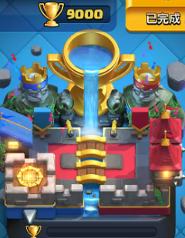
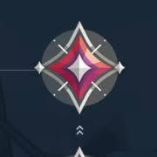
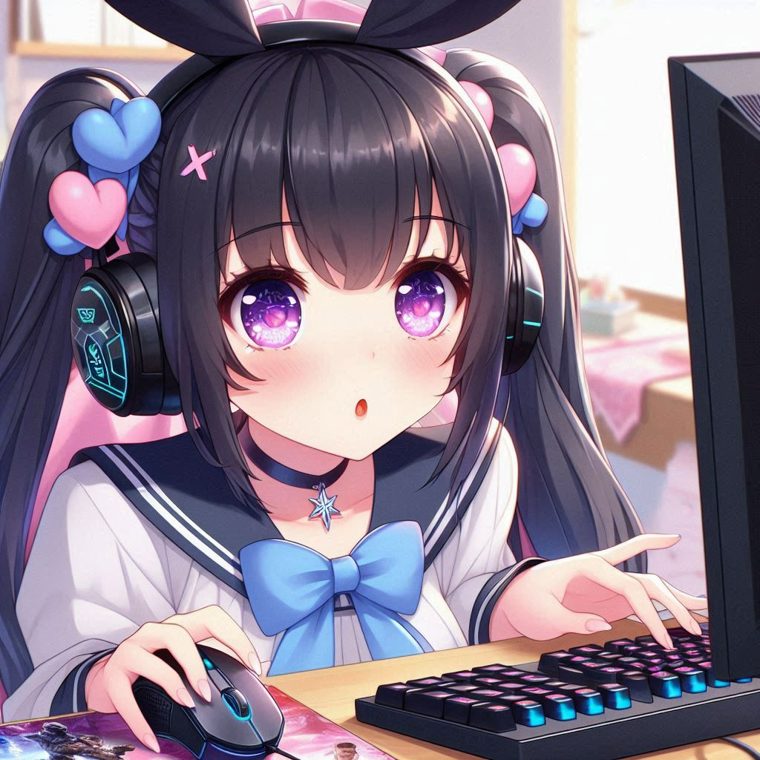

轉彎
Notes:
Anime style. Playing scene . A girl holding a mouse and pressing keyboard 、staring at computer screen to play FPS game such as Apex. She has long black hair tied into twin tails with a blue ribbon. She wears a black bunny ears headdress with a pink bow. Her eyes were large and bright pink with a slight blush and twinkle. Her nose is small and delicate, her lips are pink, her skin is fair, and she wears star-shaped earrings on her ears. She wore a white and blue dress with a red and white pattern. The dress has a deep V-neck neckline, long sleeves with white cuffs, and white lace gloves on the wrists. She also wore black pantyhose and blue heels that were decorated with a red chevron pattern.
在出道前的我每天基本上都在確認各項委託的進度、精進語言、泡在網路上觀察時下流行，以及打FPS遊戲和手遊練習。
結果意外發現自己好像有點天分，將目前流行的APEX打到大師、VALORANT打到神話、手遊也打到最高段位。
目前看來開台後繼續精進打到最高段位甚至世界排名也是有點希望的!

Slide 10

結局
Notes:
Anime style. A girl feels released and breath out happily. She has long black hair tied into twin tails with a blue ribbon. She wears a black bunny ears headdress with a pink bow. Her eyes were large and bright pink with a slight blush and twinkle. Her nose is small and delicate, her lips are pink, her skin is fair, and she wears star-shaped earrings on her ears. She wore a white and blue dress with a red and white pattern. The dress has a deep V-neck neckline, long sleeves with white cuffs, and white lace gloves on the wrists. She also wore black pantyhose and blue heels that were decorated with a red chevron pattern.
最後，總算完成所有出道前委託的來往交涉，素材也都順利在初配信前搞定! 也確保了會有固定人數的觀眾來觀看!
剩下就是當天不要太過緊張結果搞砸就好

Slide 11
Notes:
在決定以個人勢的身分出道之後，開始陸續準備各種開台需要的東西，像是出道預告、影片素材、找PV師、確認開台環境的隔音和收音設備沒問題等等。
希望能夠在萬全的準備下給觀眾一個完美的初配信(出道直播)!
由於是個人一手包辦，所以需要不斷學習各種技能，OBS、LIVE2D、封面製作、文案和企劃書撰寫等等才可以盡可能減少開支。
但是除此之外，為了讓初配信有人來看，決定在出道前100天每日製作並上傳SHORTS增加曝光度。
因此不會剪輯的我必須在短時間內學會如何剪輯、挑選素材、跟隨演算法等等。
為了能夠順利出道，我拚盡了全力，日以繼夜地學習和加強新技能，甚至可能不會用到的都一併學了起來、像是3D建模、Vroid 模型製作、unity和github的基礎使用等。
怕以後和日本的朋友合作開台時無法快速理解他們的梗，連日本文化、日本文學史、日本近現在文學都特地去上了課。
在邊吸收知識的同時每日製作shorts並上傳，痛苦卻充實地度過每一天
總算在努力半年後，差不多將開台與未來會使用到的技能都學會了，shorts也發滿一百天在出道前順利得到一萬訂閱後，正式決定在愚人節當天出道!
在忙東忙西，正式訂下出道日期後才突然想到，自己忘記去了解和練習現在的流行遊戲，特別是FPS遊戲，畢竟相較其他遊戲更能夠持續的吸引觀眾的目光!
因此，我緊急開辦帳號大量看遊戲教學影片，在出道前奠定好遊戲基礎避免以後被說什麼都沒準備就來打遊戲，直播效果也會大大扣分。
在出道前的我每天基本上都在確認各項委託的進度、精進語言、泡在網路上觀察時下流行，以及打FPS遊戲和手遊練習。
結果意外發現自己好像有點天分，將目前流行的APEX打到大師、VALORANT打到神話、手遊也打到最高段位。
目前看來開台後繼續精進打到最高段位甚至世界排名也是有點希望的!
最後，總算完成所有出道前委託的來往交涉，素材也都順利在初配信前搞定! 也確保了會有固定人數的觀眾來觀看!
剩下就是當天不要太過緊張結果搞砸就好。

